Slide 1
Consumer Surplus and Producer Surplus
Dr. Jalandhar Pradhan

Slide 2
Consumer Surplus
Consumer Surplus The difference between the maximum amount a person is willing to pay for a good and its current market price.
diamond/water paradox A paradox stating that (1) the things with the greatest value in use frequently have little or no value in exchange, and (2) the things with the greatest value in exchange frequently have little or no value in use.

Slide 3
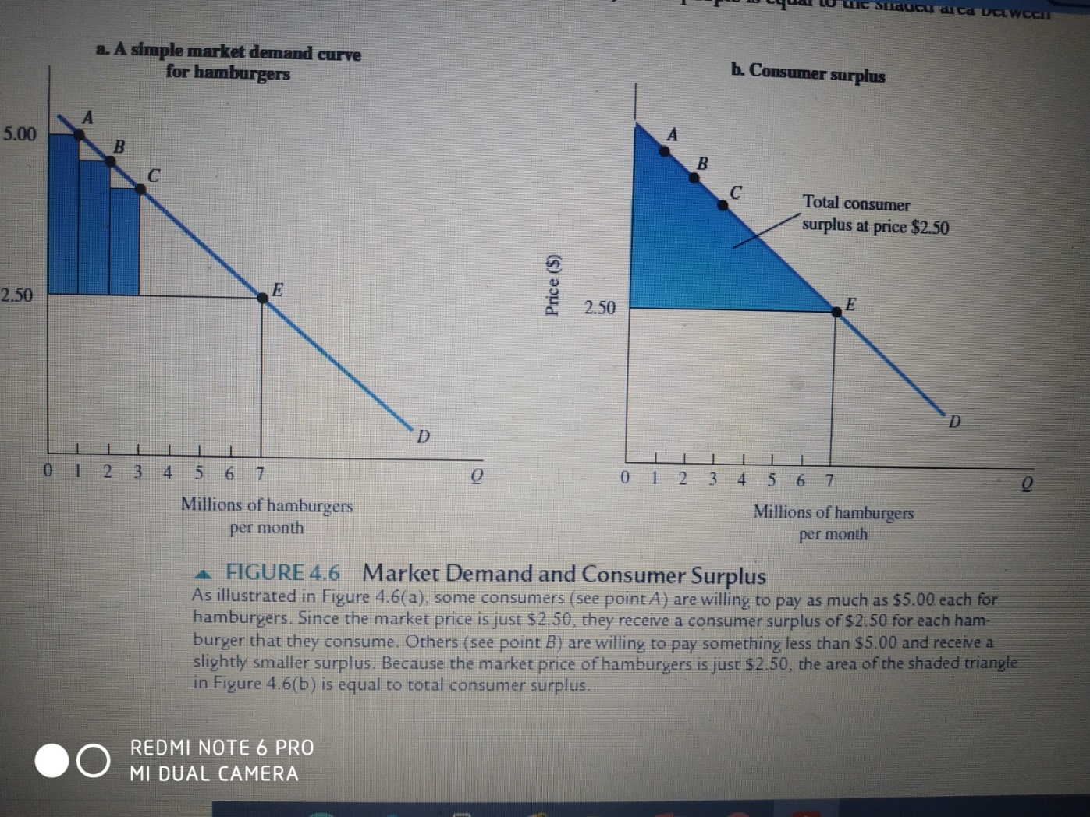
Consumer Surplus

Slide 4
Producer Surplus
Producer Surplus The difference between the current market price and the cost of production for the firm.

Slide 5
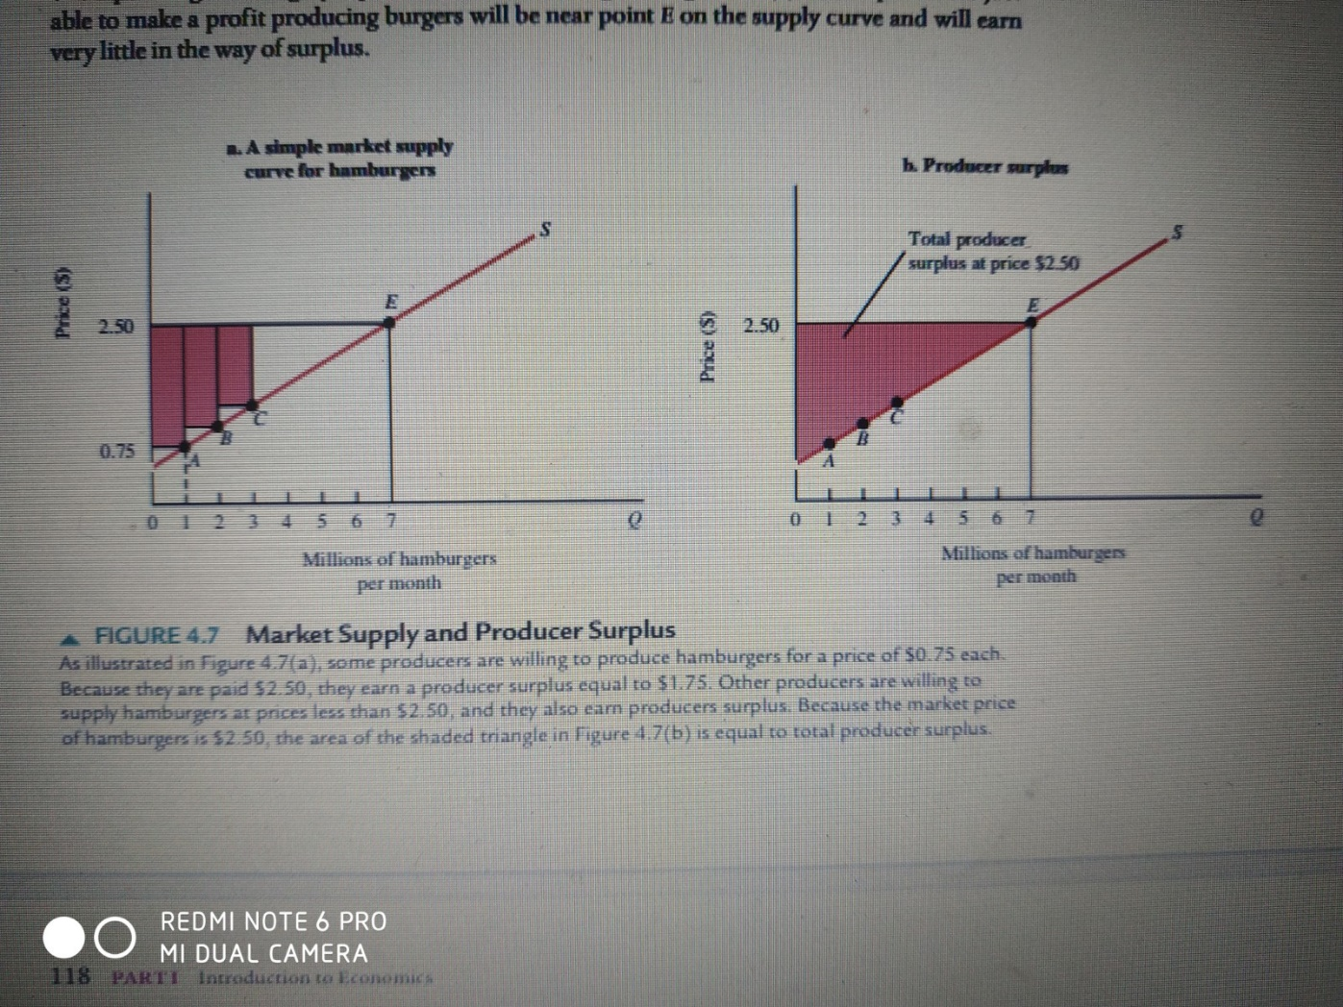
Producer Surplus

Slide 6
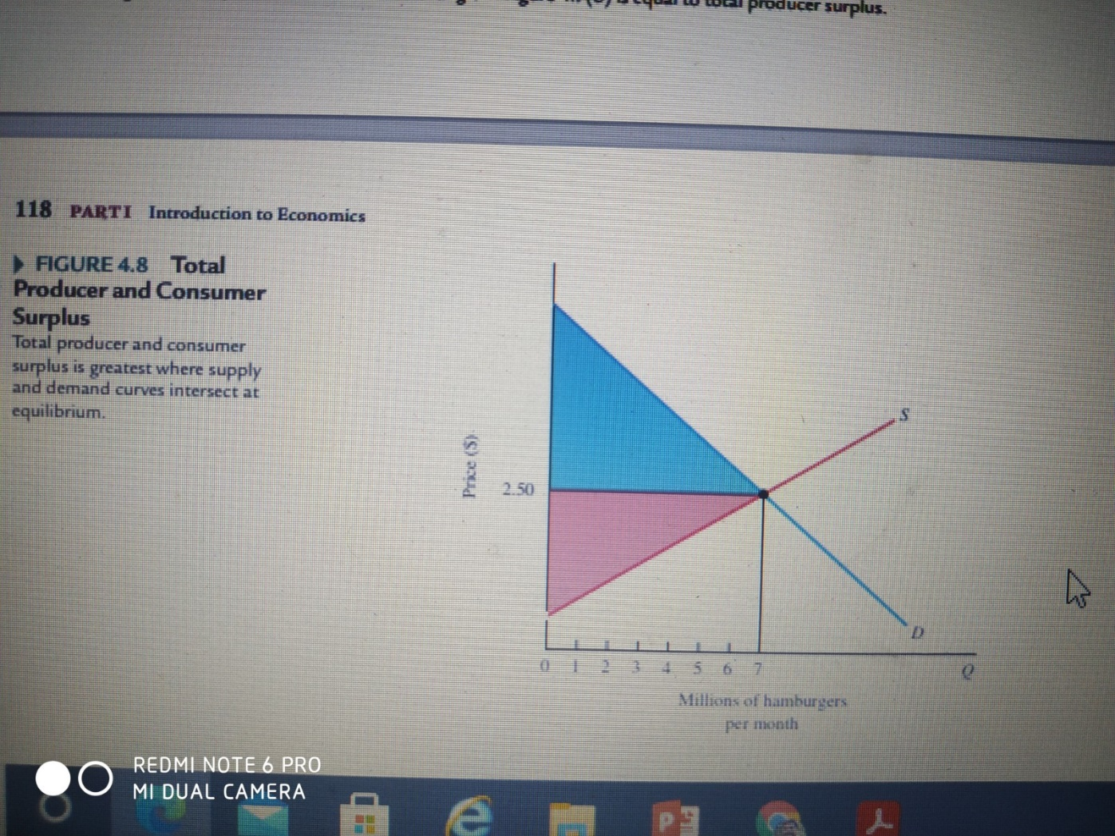
Total Producer and Consumer surplus

Slide 7
Deadweight Loss
Deadweight Loss The total loss of producer and consumer surplus from underproduction or overproduction.

Slide 8
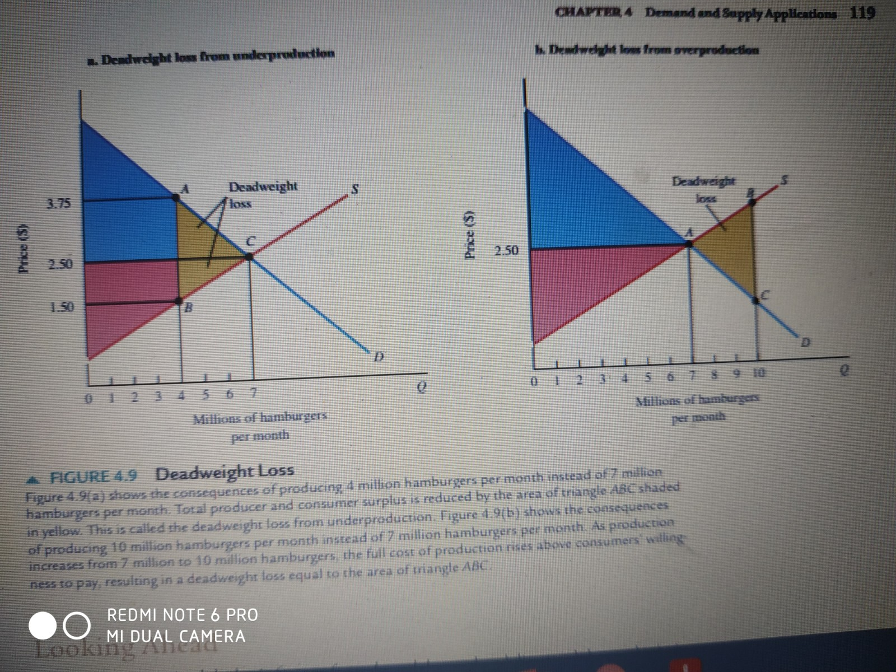
Deadweight Loss

Slide 9
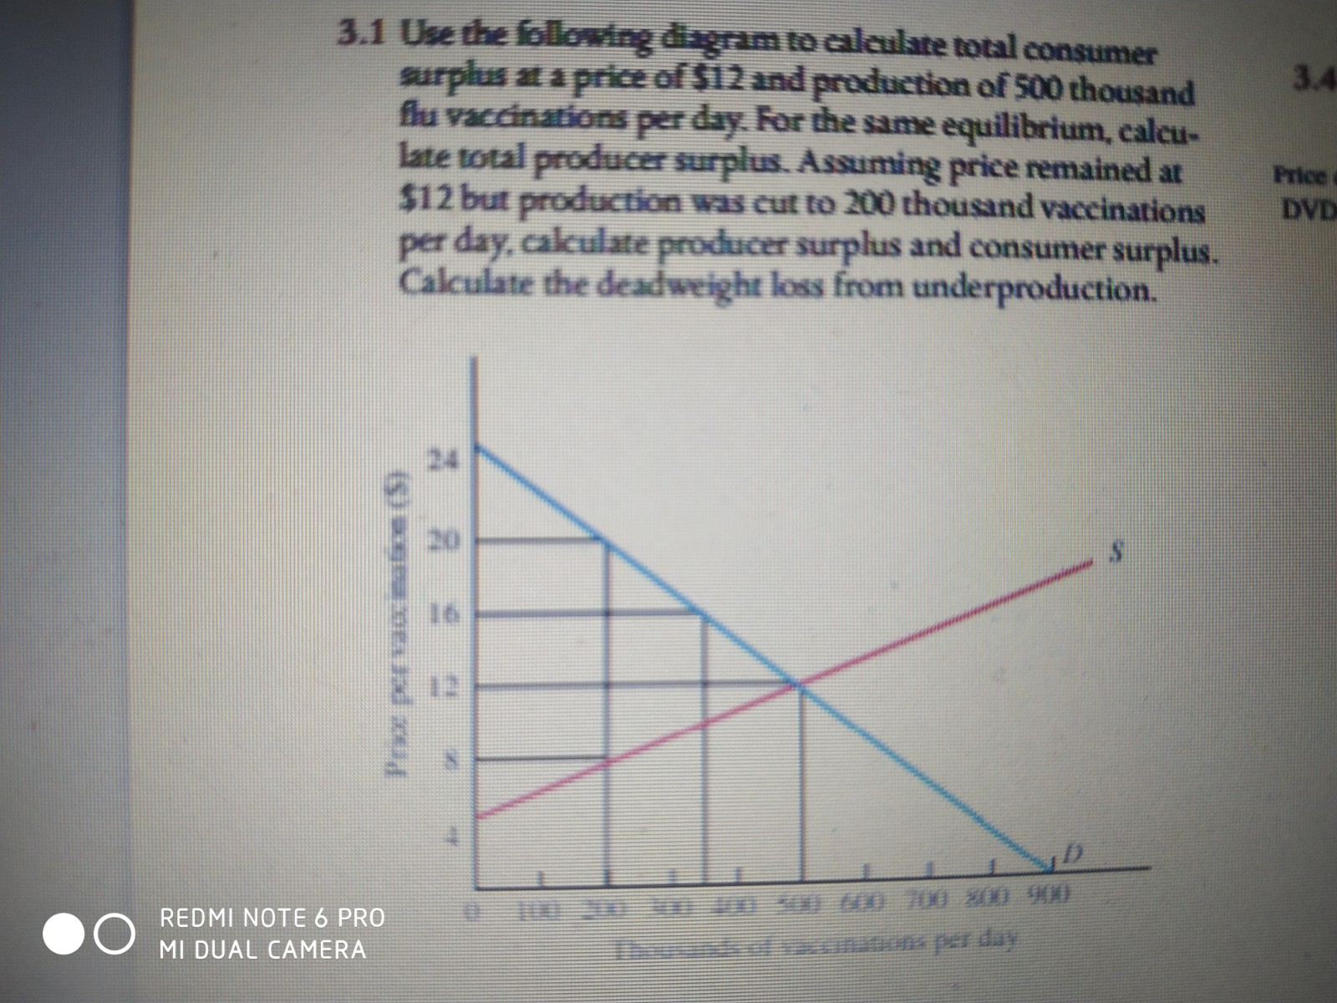
Estimate CS and PS

